Slide 1
UNIT 8 Registers and Counters
Prepared by
Er.Harendra Bikram Shah
(Lecturer)
Department of Computer Engineering

Slide 2
OUTLINES
Registers and Its Types
Counters and its Types

Slide 3
Registers and Its Types
Flip-flop is a 1 bit memory cell which can be used for storing the digital data. i.e. 0 or 1
Group of flip-flop is known as a Register.
The n-bit register will consist of n number of flip-flop and it is capable of storing an n-bit word.
Types of Registers:
On the basis of IP/OP:
SISO b. SIPO c. PISO d. PIPO
2. On the Basis of Application:
Shift Registers
Storage Registers

Slide 4
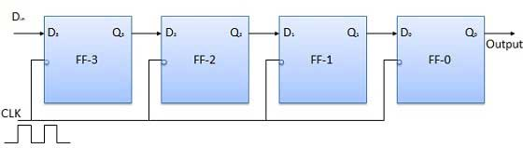
Registers on the basis of Shift application
There are four modes of operations of a shift register.
Serial Input Serial Output
Serial Input Parallel Output
Parallel Input Serial Output
Parallel Input Parallel Output
Serial Input Serial Output

Slide 5
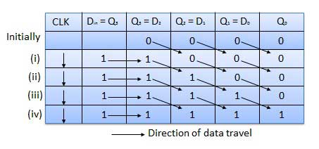
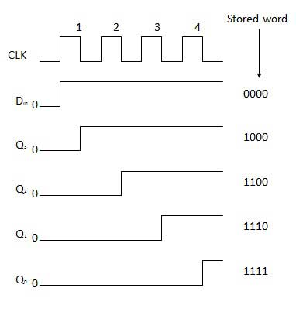

Slide 6
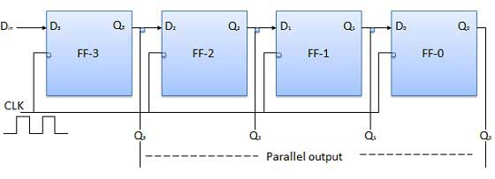
Serial Input Parallel Output

Slide 7
Serial Input Parallel Output

Slide 8
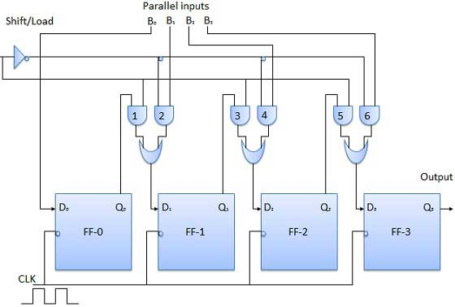
Parallel Input Serial Output

Slide 9
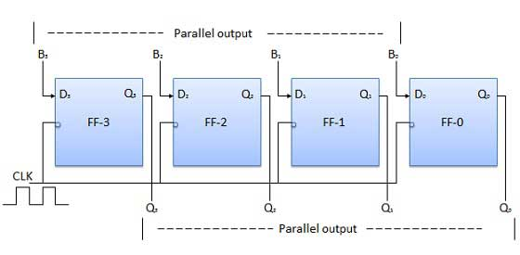
Parallel Input Parallel Output

Slide 10
Applications of shift Registers
The shift registers are used for temporary data storage.
The shift registers are also used for data transfer and data manipulation.
The serial-in serial-out and parallel-in parallel-out shift registers are used to produce time delay to digital circuits.
The serial-in parallel-out shift register is used to convert serial data into parallel data thus they are used in communication lines where demultiplexing of a data line into several parallel line is required.
A Parallel in Serial out shift register us used to convert parallel data to serial data.

Slide 11
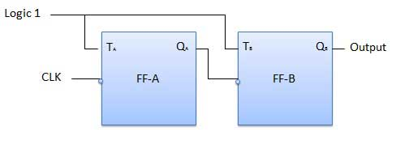
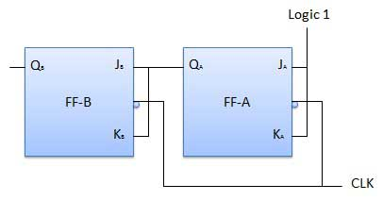
Counters and its Types
Counter is a sequential circuit. That is used for counting pulses is known counter.
Counter is the widest application of flip-flops.
It is a group of flip-flops with a clock signal applied.
Counters are of two types.
Asynchronous or ripple counters.
Synchronous counters.
Asynchronous or ripple counters.
Synchronous counters

Slide 12
Classification of counters
Depending on the way in which the counting progresses, the synchronous or asynchronous counters are classified as follows −
Up counters
Down counters
Up/Down counters
Other counters are :
Decade Counter
Johnson Counter
Application of counters
Frequency counters
Digital clock
Time measurement
A to D converter
Frequency divider circuits
Digital triangular wave generator

Slide 13
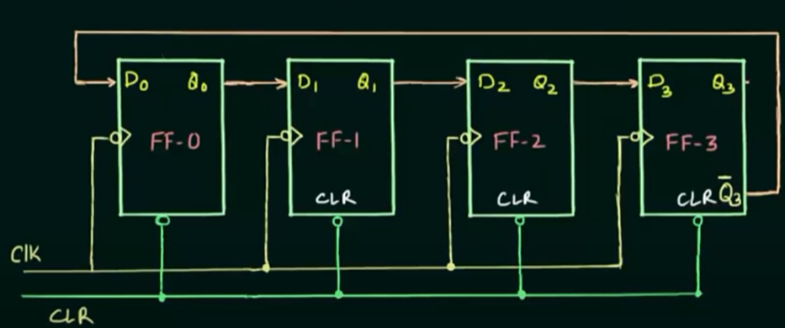
Johnson Counter(Switch Tail/Twisted Ring Counter)
The Johnson counter is similar to the Ring counter.
The only difference between the Johnson counter and the ring counter is that the outcome of the last flip flop is passed to the first flip flop as an input.
But in Johnson counter, the inverted outcome Q' of the last flip flop is passed as an input.
The remaining work of the Johnson counter is the same as a ring counter.
The Johnson counter is also referred to as the Creeping counter.
4-bit Johnson counter

Slide 14
Truth Table
CP | Q₀ | Q₁ | Q₂ | Q₃
0 | 0 | 0 | 0 | 0
1 | 1 | 0 | 0 | 0
2 | 1 | 1 | 0 | 0
3 | 1 | 1 | 1 | 0
4 | 1 | 1 | 1 | 1
5 | 0 | 1 | 1 | 1
6 | 0 | 0 | 1 | 1
7 | 0 | 1 | 1 | 1

Slide 15
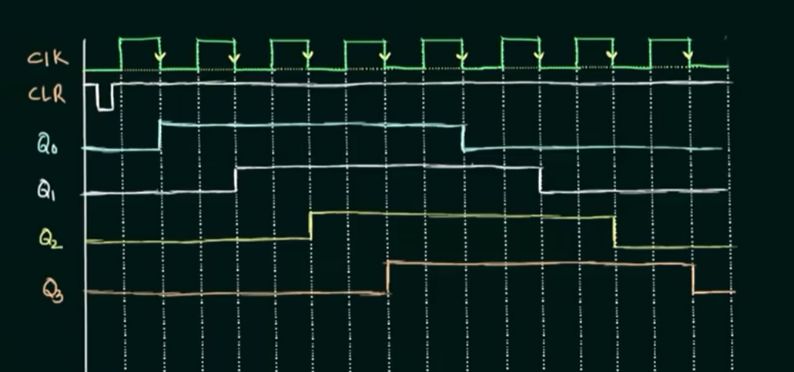

Slide 16
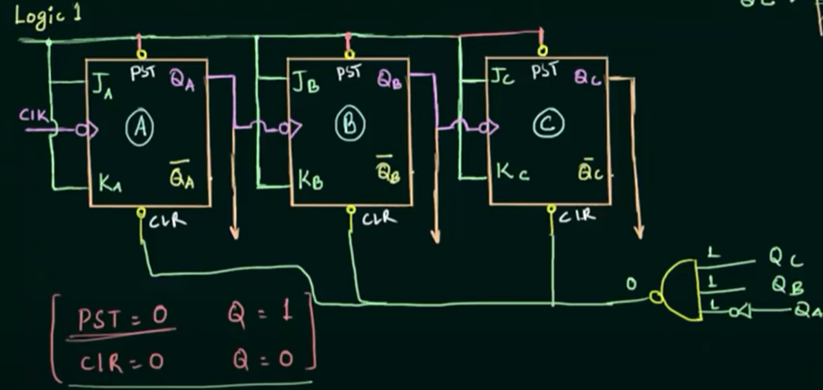
MOD-6 Counter

Slide 17
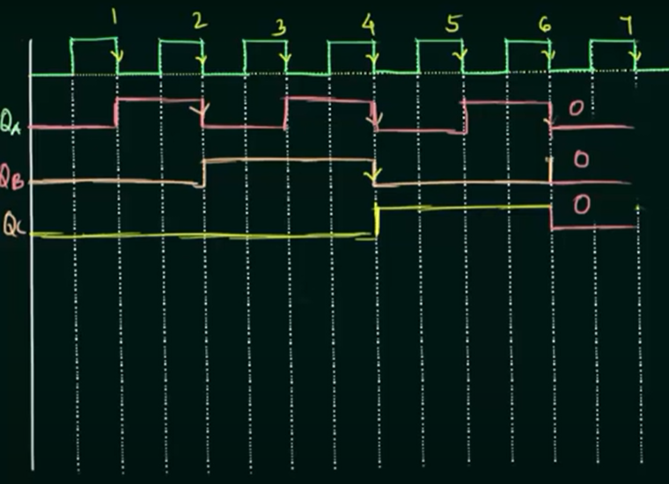
MOD-6 Counter Timing Diagram

